Slide 1

Noida Institute of Engineering and Technology, Greater Noida
Mobile Application Development
ACSIOT0401
Unit: IV
Android Application Deployment
Vatika Jalali
Assistant Professor
IoT Department
4th Semester
(IoT)

Slide 2







Faculty Profile
Responsibilities
Faculty IoT,
Mentor IoT
Research Interests
Digital Image processing,
Machine Learning
Ms. Vatika Jalali
Assistant Professor, IoT
Education
M.Tech CSE, PTU
B.Tech CSE, HPTU
Publications
Research Paper: 4
Work Exp.
NIET, Gr. Noida (September, 2022 to till date)
Worked at Chandigarh University
Ms. Vatika Jalali Mobile Application Development Unit-4

Slide 3
Evaluation Scheme
Sl. No. | Subject Codes | Subject Name | Periods |  |  | Evaluation Scheme |  |  |  | End Semester |  | Total | Credit
 |  |  | L | T | P | CT | TA | TOTAL | PS | TE | PE
1 | AAS0402 | Engineering Mathematics- IV | 3 | 1 | 0 | 30 | 20 | 50 |  | 100 |  | 150 | 4
2 | AASL0401 | Technical Communication | 2 | 1 | 0 | 30 | 20 | 50 |  | 100 |  | 150 | 3
3 | ACSE0403B | Operating Systems | 3 | 0 | 0 | 30 | 20 | 50 |  | 100 |  | 150 | 3
4 | ACSAI0402 | Database Management Systems | 3 | 1 | 0 | 30 | 20 | 50 |  | 100 |  | 150 | 4
5 | ACSIOT0401 | Mobile Application Development | 3 | 0 | 0 | 30 | 20 | 50 |  | 100 |  | 150 | 3
6 | ACSE0404 | Theory of Automata and Formal Languages | 3 | 0 | 0 | 30 | 20 | 50 |  | 100 |  | 150 | 3
7 | ACSE0453B | Operating Systems Lab | 0 | 0 | 2 |  |  |  | 25 |  | 25 | 50 | 1
8 | ACSAI0452 | Database Management Systems Lab | 0 | 0 | 2 |  |  |  | 25 |  | 25 | 50 | 1
9 | ACSIOT0451 | Mobile Application Development Lab | 0 | 0 | 2 |  |  |  | 25 |  | 25 | 50 | 1
10 | ACSE0459 | Mini Project using Open Technology | 0 | 0 | 2 |  |  |  | 50 |  |  | 50 | 1
11 | ANC0402 / ANC0401 | Environmental Science*/ Cyber Security*(Non Credit) | 2 | 0 | 0 | 30 | 20 | 50 |  | 50 |  | 100 | 0
 |  | MOOCs** (For B.Tech. Hons. Degree)
 |  | GRAND TOTAL |  |  |  |  |  |  |  |  |  | 1100 | 24

Slide 4
Syllabus
Course Contents / Syllabus
UNIT-I | Introduction to Mobile Application and Architecture | 8 Hours
Mobile applications, History of mobile application frameworks, Characteristics and types of mobile applications, Achieving quality constraints. Mobile Architecture- Mobile Hardware Architecture: processors used for Mobile and Handheld devices and SoC architecture; Mobile Software Architecture: Real Time Operating systems and Mobile Real Time Operating Systems, SDK’s.
UNIT-II | Android Developing Environment | 6 Hours
Introduction to Android, Android ecosystem, Android SDK and Installation, Layered Architecture of Android, Android API levels (versions & version names), Android Development Tools, Basic Building blocks – Protocols, Activities, Services, Broadcast Receivers & Content providers.
UNIT-III | UI Components and Multimedia | 10 Hours
Fundamental UI design, layout and view types, Interaction with server-side applications – Using Google Maps, GPS and Wi-Fi, Integration with social media applications, Interfacing sensor data with mobile application, Accessing applications hosted in a cloud computing environment. Multimedia Supported audio and video formats, Audio capture, Bluetooth, Animation.

Slide 5
Syllabus
UNIT-IV | Android Application Deployment | 8 Hours
Persisting data using SQLite database, Testing and debugging Android Application, Packaging and Android Application Deployment on device with Windows, Android Permissions. Testing and publishing of Mobile Applications on different app stores.
UNIT-V | iOS and Swift | 8 Hours
Introduction to Objective C, iOS features, UI implementation, Touch frameworks, Data persistence using Core Data and SQLite, Location aware applications using Core Location and Map Kit, integrating calendar and address book with social media application, using Wifi - iPhone marketplace. Swift: Introduction to Swift, Features of swift.

Slide 6
Branch wise Applications
A mobile app is a medium between an IoT device and a mobile phone.
The app works as the primary interface through which we can manage smart things.
Mobile IoT apps supplement and enhance the use of IoT to make it work more efficiently.

Slide 7
Course Objective
This course introduces students to programming technologies, design and development related to mobile applications using android/ iOS.
Course also aims at mobile application development frameworks; mobile architecture, design and engineering issues, techniques, methodologies for mobile application development.

Slide 8


Course Outcomes
Course outcomes : After completion of this course students will be able to
CO 1 | Recall vision, definition, conceptual framework, architecture of mobile applications. | K1
CO 2 | Describe and configure android development environment, tools, and architecture. | K2
CO 3 | Create and implement UI components and multimedia framework, fragments, audio capture, animation, and other activities. | K6
CO 4 | Integrate and interact with server-side applications with testing and deployment of android application. | K3
CO 5 | Analyze iOS and swift features, frameworks, map kit, and social media applications. | K4

Slide 9
CO-PO Mapping
Mapping of Course Outcomes and Program Outcomes:
CO.k | PO1 | PO2 | PO3 | PO4 | PO5 | PO6 | PO7 | PO8 | PO9 | PO10 | PO11 | PO12
ACSIOT0401.1 | 3 | 3 | 1 | 3 | 2 | 1 | 1 | 3 | 1 | 2 | 2 | 2
ACSIOT0401.2 | 3 | 3 | 2 | 3 | 3 | 2 | 3 | 3 | 2 | 2 | 3 | 2
ACSIOT0401.3 | 3 | 3 | 2 | 3 | 3 | 3 | 3 | 3 | 2 | 2 | 3 | 3
ACSIOT0401.4 | 3 | 3 | 2 | 3 | 2 | 1 | 1 | 3 | 1 | 1 | 2 | 2
ACSIOT0401.5 | 3 | 3 | 2 | 3 | 3 | 2 | 3 | 3 | 2 | 2 | 3 | 2
Average | 3 | 3 | 1.8 | 3 | 2.6 | 1.8 | 2.4 | 3 | 1.8 | 1.8 | 2.6 | 2.2
3= High, 2=Medium, 1=Low

Slide 10
Result Analysis
Subject | No. of students | Min Marks | Max Marks | Over all Result
Mobile Application Development | 40 | 30 | 80 | 95%

Slide 11
Ge
End Semester Question paper Templates
General Instructions:
All questions are compulsory. Answers should be brief and to the point.
This Question paper consists of …………pages & …8………questions.
It comprises of three Sections, A, B, and C. You are to attempt all the sections.
Section A -Question No- 1 is objective type questions carrying 1 mark each, Question No- 2 is very short
answer type carrying 2 mark each. You are expected to answer them as directed.
Section B - Question No-3 is Long answer type -I questions with external choice carrying 6 marks each.
You need to attempt any five out of seven questions given.
Section C - Question No. 4-8 are Long answer type –II (within unit choice) questions carrying 10 marks
each. You need to attempt any one part a or b.
Students are instructed to cross the blank sheets before handing over the answer sheet to the invigilator.
No sheet should be left blank. Any written material after a blank sheet will not be evaluated/checked.

Slide 12
 |  | SECTION – A |  | CO
 | Attempt all parts- |  | [10×1=10]
 | 1-a. | Question- | (1)
 | 1-b. | Question- | (1)
 | 1-c. | Question- | (1)
 | 1-d. | Question- | (1)
 | 1-e. | Question- | (1)
 | 1-f. | Question- | (1)
 | 1-g. | Question- | (1)
 | 1-h. | Question- | (1)
 | 1-i. | Question- | (1)
 | 1-j. | Question- | (1)
2. | Attempt all parts- |  | [5×2=10] | CO
 | 2-a. | Question- | (2)
 | 2-b. | Question- | (2)
 | 2-c. | Question- | (2)
 | 2-d. | Question- | (2)
 | 2-e. | Question- | (2)

Slide 13
SECTION – B |  |  |  | CO
3. | Answer any five of the following- |  | [5×6=30]
 | 3-a. | Question- | (6)
 | 3-b. | Question- | (6)
 | 3-c. | Question- | (6)
 | 3-d. | Question- | (6)
 | 3-e. | Question- | (6)
 | 3-f. | Question- | (6)
 | 3-g. | Question- | (6)
SECTION – C |  |  |  | CO
4 | Answer any one of the following- |  | [5×10=50]
 | 4-a. | Question- | (10)
 | 4-b. | Question- | (10)
5. | Answer any one of the following-
 | 5-a. | Question- | (10)
 | 5-b. | Question- | (10)
6. | Answer any one of the following-
 | 6-a. | Question- | (10)
 | 6-b. | Question- | (10)
7. | Answer any one of the following-
 | 7-a. | Question- | (10)
 | 7-b. | Question- | (10)
8. | Answer any one of the following-
 | 8-a. | Question- | (10)
 | 8-b. | Question- | (10)

Slide 14
Prerequisites
Overview of programming language
JAVA and XML.

Slide 15
Brief Introduction about the Subject with videos
Mobile application development is the process of creating software applications that run on a mobile device, and a typical mobile application utilizes a network connection to work with remote computing resources.
Hence, the mobile development process involves creating installable software bundles (code, binaries, assets, etc.) , implementing backend services such as data access with an API, and testing the application on target devices.
https://www.youtube.com/watch?v=bOiCw-ZZlGA
https://www.youtube.com/watch?v=09TeUXjzpKs&t=5270s

Slide 16
Recap of unit 3
Discussed about the key concepts of UI components.
Discussed about the integration with social media.
Understood the interfacing of sensor data with mobile application
Accessed the applications hosted in a cloud computing environment
Understood the installation of Android and using the basics
Understood the multimedia interaction with android.

Slide 17
Unit Contents
Persisting data using SQLite database
Testing and debugging Android Application
Packaging on device with Windows
Android Application Deployment on device with Windows
Android Permissions
Testing and publishing of Mobile Applications on different app stores.

Slide 18
Unit Objective
To understand key concepts of data storage in android.
To know the basics of SQLite database.
To understand the testing and debugging of android applications.
To understand the concept of packaging and deployment of android apps.
To understand the concept of android permissions.
To understand the testing and publishing of mobile applications on different app stores.

Slide 19
Android SQLite
Topic Objective: To understand the concept of SQLite Database
SQLite is an open-source relational database i.e. used to perform database operations on android devices such as storing, manipulating or retrieving persistent data from the database.
It is embedded in android by default. So, there is no need to perform any database setup or administration task.
SQLite is a Structure query base database, open source, light weight, no network access and standalone database.
SQLite Database is an open-source database provided in Android which is used to store data inside the user’s device in the form of a Text file.
We can perform so many operations on this data such as adding new data, updating, reading, and deleting this data.
SQLite is an offline database that is locally stored in the user’s device and we do not have to create any connection to connect to this database.

Slide 20
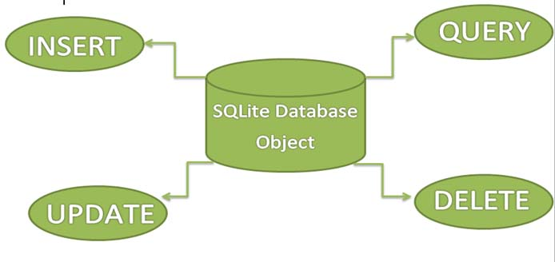
Android SQLite Features
SQLite supports all the relational database features.
In order to access this database, no need to establish any kind of connections for it like JDBC,ODBC e.t.c
Source: https://abhiandroid.com/database/sqlite

Slide 21
DAILY QUIZ 1
Which database is natively supported by android?
MSSQL
MySQL
SQLite
Oracle
2. SQLite is a ? a. NoSQL database b. Distributed database c. Relational database d. Operational database
3. SQLite written in? (C/JAVA)
4. SQLite is an in-process library that implements a?
a. self-contained b. serverless c. zero-configuration d. All of the above

Slide 22
Android SQLite Database Steps
Topic Objective: To understand the steps involved in SQLite Database creation
Creating And Updating Database In Android
For creating, updating and other operations you need to create a subclass or SQLiteOpenHelper class.
SQLiteOpenHelper is a helper class to manage database creation and version management.
It provides two methods onCreate(SQLiteDatabase db), onUpgrade(SQLiteDatabase db, int oldVersion, int newVersion).
The SQLiteOpenHelper is responsible for opening database if exist, creating database if it does not exists and upgrading if required.
The SQLiteOpenHelper only require the DATABASE_NAME to create database. After extending SQLiteOpenHelper you will need to implement its methods onCreate, onUpgrade and constructor.

Slide 23
Android SQLite Database Steps
Database - Package
The main package is android.database.sqlite that contains the classes to manage your own databases
Database - Creation
In order to create a database you just need to call this method openOrCreateDatabase with your database name and mode as a parameter.
It returns an instance of SQLite database which you have to receive in your own object. Its syntax is given below:
SQLiteDatabase mydatabase = openOrCreateDatabase("your database name",MODE_PRIVATE,null);
Source: https://abhiandroid.com/database/sqlite

Slide 24
Data Storage in the SQLite Database
1. onCreate(SQLiteDatabase sqLiteDatabase) method is called only once throughout the application lifecycle.
It will be called whenever there is a first call to getReadableDatabase() or getWritableDatabase() function available in super SQLiteOpenHelper class.
So SQLiteOpenHelper class call the onCreate() method after creating database and instantiate SQLiteDatabase object. Database name is passed in constructor call.
2. onUpgrade(SQLiteDatabase db,int oldVersion, int newVersion) is only called whenever there is a updation in existing version. So to update a version we have to increment the value of version variable passed in the superclass constructor.
In onUpgrade method we can write queries to perform whatever action is required. In most example you will see that existing table(s) are being dropped and again onCreate() method is being called to create tables again.
We have to change database version if we have added a new row in the database table. If we have requirement that we don’t want to lose existing data in the table then we can write alter table query in the onUpgrade(SQLiteDatabase db,int oldVersion, int newVersion) method.

Slide 25
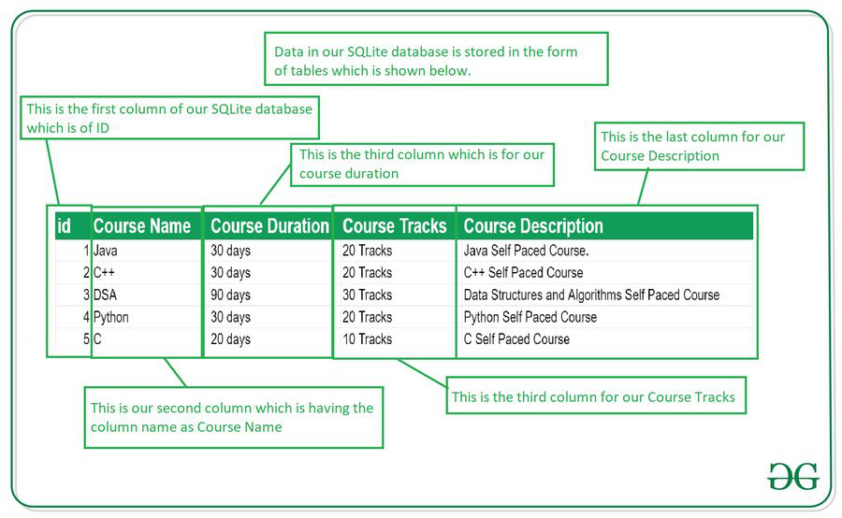
Data Storage in the SQLite Database
Topic Objective: To understand the concept of data storage in SQLite Database
Data is stored in the SQLite database in the form of tables.
When we stored this data in our SQLite database it is arranged in the form of tables that are similar to that of an excel sheet.
Below is the representation of our SQLite database which we are storing in our SQLite database.
Source: https://www.geeksforgeeks.org/how-to-create-and-add-data-to-sqlite-database-in-android/?ref=lbp

Slide 26
Important Methods in SQLite Database
Method | Description
getColumnNames() | This method is used to get the Array of column names of our SQLite table.
getCount() | This method will return the number of rows in the cursor.
isClosed() | This method returns a Boolean value when our cursor is closed.
getColumnCount() | This method returns the total number of columns present in our table.
getColumnName(int columnIndex) | This method will return the name of the column when we passed the index of our column in it.
getColumnIndex(String columnName) | This method will return the index of our column from the name of the column.
getPosition() | This method will return the current position of our cursor in our table.
Source: https://www.geeksforgeeks.org/how-to-create-and-add-data-to-sqlite-database-in-android/?ref=lbp

Slide 27
Important Methods in SQLite Database
Sr.No | Method & Description
1 | openDatabase(String path, SQLiteDatabase.CursorFactory factory, int flags, DatabaseErrorHandler errorHandler) This method only opens the existing database with the appropriate flag mode. The common flags mode could be OPEN_READWRITE OPEN_READONLY
2 | openDatabase(String path, SQLiteDatabase.CursorFactory factory, int flags) It is similar to the above method as it also opens the existing database but it does not define any handler to handle the errors of databases
3 | openOrCreateDatabase(String path, SQLiteDatabase.CursorFactory factory) It not only opens but create the database if it not exists. This method is equivalent to openDatabase method.
4 | openOrCreateDatabase(File file, SQLiteDatabase.CursorFactory factory) This method is similar to above method but it takes the File object as a path rather then a string. It is equivalent to file.getPath()
Source: https://www.tutorialspoint.com/android/android_sqlite_database.htm

Slide 28
Database Commands
Topic Objective: To understand the various important commands used in SQLite
Database - Insertion
we can create table or insert data into table using execSQL method defined in SQLiteDatabase class.
Its syntax is given below
mydatabase.execSQL("CREATE TABLE IF NOT EXISTS Table1
(Username VARCHAR,Password VARCHAR);");
mydatabase.execSQL("INSERT INTO Table1 VALUES('admin','admin');");
Source: https://www.tutorialspoint.com/android/android_sqlite_database.htm

Slide 29
Database Commands
Topic Objective: To understand the various important commands used in SQLite
Database – Fetching
We can retrieve anything from database using an object of the Cursor class. We will call a method of this class called rawQuery and it will return a resultset with the cursor pointing to the table.
We can move the cursor forward and retrieve the data.
Cursor resultSet = mydatbase.rawQuery("Select * from Table1",null);
resultSet.moveToFirst(); String username = resultSet.getString(0); String password = resultSet.getString(1);
Source: https://www.tutorialspoint.com/android/android_sqlite_database.htm

Slide 30
Example demonstrating the use of SQLite Database
Topic Objective: To understand the various important commands used in SQLite
Steps | Description
1 | You will use Android studio to create an Android application under a package com.example.aditee.myapplication.
2 | Modify src/MainActivity.java file to get references of all the XML components and populate the contacts on listView.
3 | Create new src/DBHelper.java that will manage the database work
4 | Create a new Activity as DisplayContact.java that will display the contact on the screen
5 | Modify the res/layout/activity_main to add respective XML components
6 | Modify the res/layout/activity_display_contact.xml to add respective XML components
7 | Modify the res/values/string.xml to add necessary string components
8 | Modify the res/menu/display_contact.xml to add necessary menu components
9 | Create a new menu as res/menu/mainmenu.xml to add the insert contact option
10 | Run the application and choose a running android device and install the application on it and verify the results.
https://www.tutorialspoint.com/android/android_sqlite_database.htm

Slide 31
DAILY QUIZ 2
Which command is used to modifies an existing database object, such as a table? A. Create B. Alter C. Drop D. Modify
2. SQLite dot commands and exception should not be terminated by? A. : B. / C. ; D. ‘
3. Does SQLite is case insensitive? (T/F)
4. In android, SQLite database save data in …………. (External/Internal storage)

Slide 32
Persistent Data Storage
Topic Objective: To understand the concept of persistent data storage in SQLite
Persistent data is data which you want to be available even after you fully close and restart your app.
Android supports the following ways of storing data in the local file system:
Files - You can create and update files
Preferences - Android allows you to save and retrieve persistent key-value pairs of primitive data type. (Light weight mechanism)
SQLite database - instances of SQLite databases are also stored on the local file system.
Files are saved in the files folder and application settings are saved as XML files in the shared_prefs folder.
If your application creates an SQLite database this database is saved in the main application directory under the databases folder.

Slide 33
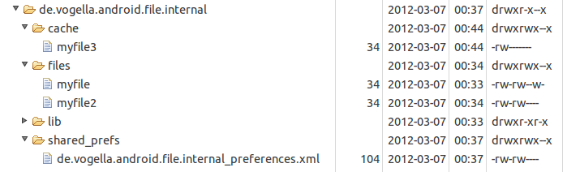
Persistent Data Storage
1. Files
The following screenshot shows a file system which contains file, cache files and preferences.
Only the application can write into its application directory.
It can create additional sub-directories in this application directory.
For these sub-directories, the application can grant read or write permissions for other applications.
https://www.vogella.com/tutorials/AndroidFileBasedPersistence/article.html

Slide 34
Persistent Data Storage
Internal and External Storage
Android has internal storage and external storage.
External storage is not private and may not always be available.
If, for example, the Android device is connected with a computer, the computer may mount the external system via USB and that makes this external storage not available for Android applications.
2. Preferences
Storing key-value pair
The SharedPreferences class allows to persists key-value pairs of primitive data types in the Android file system.
The PreferenceManager class provides methods to get access to these preferences. The following code shows how to access preferences from a certain file.
# getting preferences from a specified file
SharedPreferences settings = getSharedPreferences("Test", Context.MODE_PRIVATE);
Preferences should be created private for the application. They can be accessed via all application components.

Slide 35
Persistent Data Storage
A default store for preferences can be accessed via the PreferenceManager.getDefaultSharedPreferences(this) method call.
Preference value are accessed via the key and the instance of the SharedPreferences class, as demonstrated in the following listing.
SharedPreferences settings = PreferenceManager.getDefaultSharedPreferences(getActivity());
String url = settings.getString("url", "n/a");

Slide 36
Persistent Data Storage
SAVING AND LOADING USER PREFERENCES
Android provides the SharedPreferences object to help you save simple application data.
Using the SharedPreferences object, the data is saved through the use of name/value pairs — specify a name for the data to be saved, and then both it and its value will be saved automatically to an XML file.
Applications use SharedPreferences object to store application data.
Create a new subfolder in the res folder and name it xml.
In this newly created folder, add a file and name it myapppreferences.xml.
Add the following contents to this file
myapppreferences.xml.
<?xml version="1.0" encoding="utf-8"?>
<PreferenceScreen
xmlns:android="http://schemas.android.com/apk/res/android">

Slide 37
Persistent Data Storage
<PreferenceCategory android:title="Category 1">
<CheckBoxPreference
android:title="Checkbox"
android:defaultValue="false"
android:summary="True or False"
android:key="checkboxPref" />
</PreferenceCategory>
<PreferenceCategory android:title="Category 2">
<EditTextPreference
android:summary="Enter a string"
android:defaultValue="[Enter a string here]"
android:title="Edit Text"
android:key="editTextPref"
/>

Slide 38
Persistent Data Storage
<RingtonePreference
android:summary="Select a ringtone"
android:title="Ringtones"
android:key="ringtonePref"
/>
<PreferenceScreen android:title="Second Preference Screen"
android:summary="Click here to go to the second Preference Screen"
android:key="secondPrefScreenPref" >
<EditTextPreference
android:summary="Enter a string"
android:title="Edit Text (second Screen)"
android:key="secondEditTextPref"
/>
</PreferenceScreen>
</PreferenceCategory>
</PreferenceScreen>

Slide 39
Persistent Data Storage
Add a new class called AppPreferenceActivity.
Write the following code in AppPreferenceActivity.java
public class AppPreferenceActivity extends PreferenceActivity
{
public void onCreate(Bundle savedInstanceState)
{
super.onCreate(savedInstanceState);
PreferenceManager prefMgr = getPreferenceManager();
prefMgr.setSharedPreferencesName("appPreferences");
//---load the preferences from an XML file---
addPreferencesFromResource(R.xml.myapppreferences);
}
}
In the AndroidManifest.xml file, add the new entry for the AppPreferenceActivity class

Slide 40
Persistent Data Storage
PERSISTING DATA TO FILES
Saving to Internal Storage
Activity.xml
<LinearLayout android:orientation="vertical" >
<TextView android:text="Please enter some text" />
<EditText android:id="@+id/txtText1" />
<Button android:id="@+id/btnSave“ android:text="Save“ android:onClick="onClickSave" />
<Button android:id="@+id/btnLoad" android:text="Load“ android:onClick="onClickLoad" />
</LinearLayout>

Slide 41
DAILY QUIZ 3
How do we get access to the preference?
(a) Via getPreference() method
(b) Via getSharedPreference() method
(c) Via getDefaultSharedPreference() method
(d) All of above
There are five different methods to store persistent data. They are: Shared Preference, Internal Storage, External Storage, Network and _____?
(a) Core Data
(b) SQLite Database
(c) Web Service
3. Name the method that enables you to obtain the path of the external storage of an Android device.
(a) getExternalStorageDirectory()
(b) getPathExternalStorageDirectory()

Slide 42
Testing Android Applications
Topic Objective: To understand the concept of android app testing
The Android framework includes an integrated testing framework that helps you test all aspects of your application and the SDK tools include tools for setting up and running test applications.
Whether you are working in IDE with ADT or working from the command line, the SDK tools help you set up and run your tests within an emulator or the device you are targeting.
Test Structure
Android's build and test tools assume that test projects are organized into a standard structure of tests, test case classes, test packages, and test projects.
Testing Tools in android
JUnit
Monkey

Slide 43
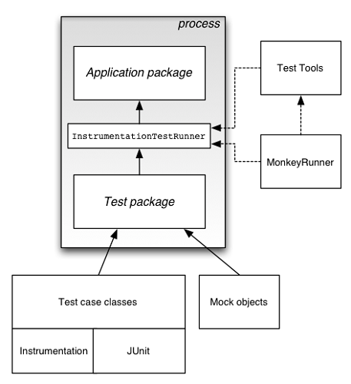
Testing Android Applications
Source: https://www.tutorialspoint.com/android/android_testing.htm

Slide 44
Testing Android Applications
Topic Objective: To understand the types of testing in android
Types of tests in Android
Mobile applications are complex and must work well in many environments. As such, there are many types of tests.
For example, there are different types of tests depending on the subject:
Functional testing: does my app do what it's supposed to?
Performance testing: does it do it quickly and efficiently?
Accessibility testing: does it work well with accessibility services?
Compatibility testing: does it work well on every device and API level?

Slide 45
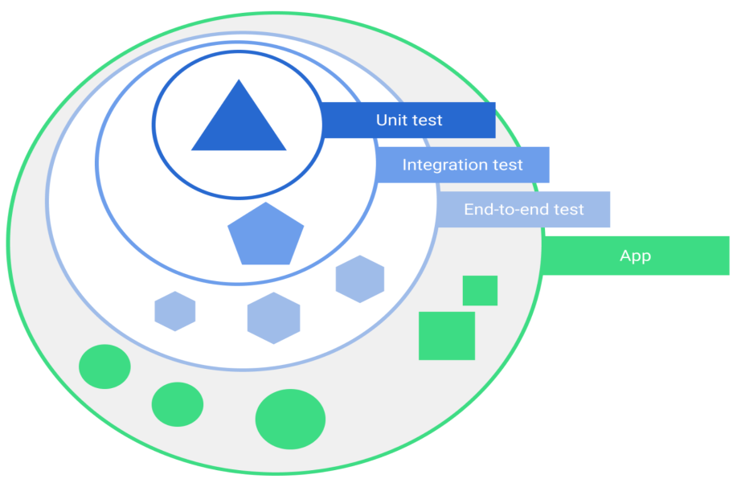
Testing Android Applications
Scope
Tests also vary depending on size, or degree of isolation:
Unit tests or small tests only verify a very small portion of the app, such as a method or class.
End-to-end tests or big tests verify larger parts of the app at the same time, such as a whole screen or user flow.
Medium tests are in between and check the integration between two or more units.
Source: https://developer.android.com/training/testing/fundamentals

Slide 46
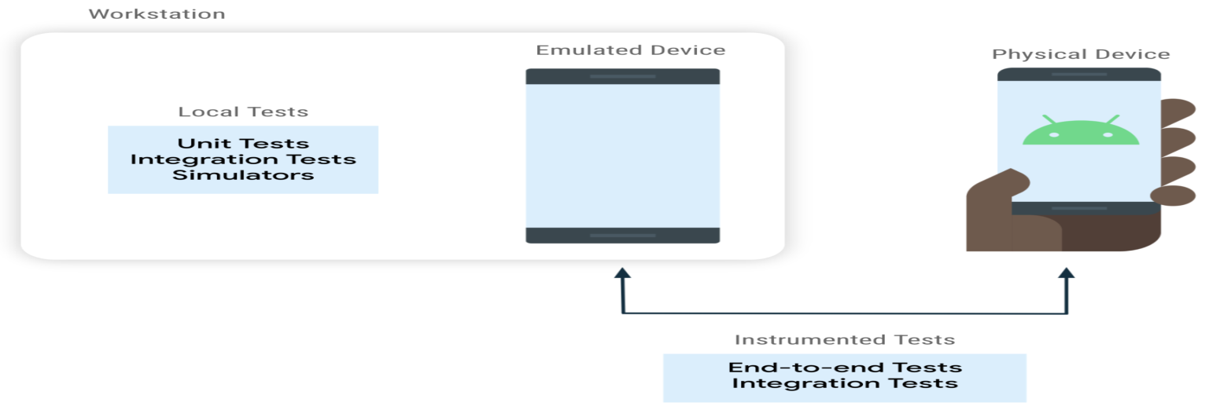
Testing Android Applications
You can run tests on an Android device or on another computer:
Instrumented tests run on an Android device, either physical or emulated. The app is built and installed alongside a test app that injects commands and reads the state. Instrumented tests are usually UI tests, launching an app and then interacting with it.
Local tests execute on your development machine or a server, so they're also called host-side tests. They're usually small and fast, isolating the subject under test from the rest of the app.
Big local test: You can use an Android simulator that runs locally, such as Robolectric.
Small instrumented test: You can verify that your code works well with a framework feature, such as a SQLite database. You might run this test on multiple devices to check the integration with multiple versions of SQLite.

Slide 47
DAILY QUIZ 4
Is the statement true . Functional testing: does my app do what it's supposed to?
What are the factors on which testing depends :
size
Degree of isolation
All of the above
3. On which device can instrumental tests run (physical, emulated, both)

Slide 48
Debugging Android Applications
Topic Objective: To understand the debugging process in android
Android Studio provides a debugger that allows you to do the following and more:
Select a device to debug your app on.
Set breakpoints in your Java, Kotlin, and C/C++ code.
Examine variables and evaluate expressions at runtime.
1. Enable debugging
Before you can begin debugging, you need to prepare as follows:
Enable debugging on your device: If you're using the emulator, this is enabled by default. But for a connected device, you need to enable debugging in the device developer options.
Run a debuggable build variant:
You must use a build variant that includes debuggable true in the build configuration. Usually, you can just select the default "debug" variant that's included in every Android Studio project (even though it's not visible in the build.gradle file). But if you define new build types that should be debuggable, you must add `debuggable true` to the build type:
android { buildTypes { create("customDebugType") { debuggable = true }}}

Slide 49
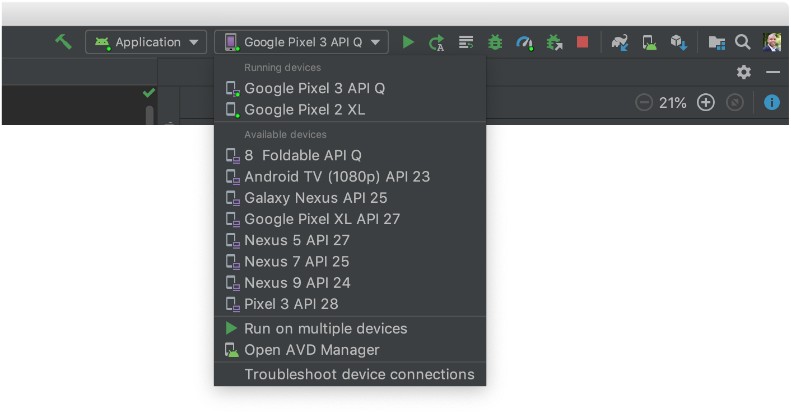
Debugging Android Applications
2. Start debugging
You can start a debugging session as follows:
Set some breakpoints in the app code.
In the toolbar, select a device to debug your app on from the target device drop-down menu.
Source: https://developer.android.com/studio/debug#kts

Slide 50
Debugging Android Applications
3. In the toolbar, click Debug
4. If the Debug window is not open, select View > Tool Windows > Debug (or click Debug in the tool window bar), and then click the Debugger tab.
Attach the debugger to a running app
If your app is already running on your device, you can start debugging without restarting your app as follows:
Click Attach debugger to Android process .
In the Choose Process dialog, select the process you want to attach the debugger to. If you're using an emulator or a rooted device, you can check Show all processes to see all processes.
Click OK. The Debug window appears
Source: https://developer.android.com/studio/debug#kts

Slide 51
DAILY QUIZ 5
1. ADB stands for -
Android debug bridge
Android delete bridge
Android destroy bridge
None of the above
2. On which of the following, developers can test the application, during developing the android applications?
Third-party emulators
Emulator included in Android SDK
Physical android phone
All of the above
3. Full form of AVD is………..

Slide 52
Publishing and Deployment of Mobile Apps
Topic Objectives:
➤ How to prepare our application for deployment
➤ Exporting our application as an APK file and signing it with a new certificate
➤ How to distribute our Android application
➤ Publishing our application on the Android Market
PREPARING FOR PUBLISHING
Google has made it relatively easy to publish Android application so that it can be quickly distributed to end users. The steps to publishing Android application generally involve the following:
1. Export application as an APK (Android Package) file.
2. Generate self-signed certificate and digitally sign the application with it.
3. Deploy the signed application.
4. Use the Android Market for hosting and selling the application.

Slide 53
Versioning our Application
Beginning with version 1.0 of the Android SDK, the AndroidManifest.xml file of every Android
application includes the android:versionCode and android:versionName attributes:
<manifest xmlns:android=”http://schemas.android.com/apk/res/android”
package=”net.learn2develop.LBS” android:versionCode=”1” android:versionName=”1.0” >
<uses-sdk android:minSdkVersion=”14” />
<uses-permission android:name=”android.permission.INTERNET”/>
<uses-permission android:name=”android.permission.ACCESS_FINE_LOCATION”/>
<uses-permission android:name=”android.permission.ACCESS_COARSE_LOCATION”/>
<application android:icon=”@drawable/ic_launcher” android:label=”@string/app_name” >
<uses-library android:name=”com.google.android.maps” />

Slide 54
Versioning our Application
<activity android:label=”@string/app_name” android:name=”.LBSActivity” >
<intent-filter >
<action android:name=”android.intent.action.MAIN” />
<category android:name=”android.intent.category.LAUNCHER” />
</intent-filter>
</activity>
</application>
</manifest>
The android:versionCode attribute represents the version number of our application.
For every revision you make to the application, you should increment this value by 1 so that you can programmatically differentiate the newest version from the previous one.
This value is never used by the Android system, but it is useful for developers as a means to obtain an application’s version number.
However, the android:versionCode attribute is used by Android Market to determine whether a newer version of your application is available.

Slide 55
Versioning our Application
The android:versionName attribute contains versioning information that is visible to users.
It should contain values in the format <major>.<minor>.<point>.
If your application undergoes a major upgrade, you should increase the <major> by 1. For small incremental updates, you can increase either the <minor> or <point> by 1.
For example, a new application may have a version name of “1.0.0.” For a small incremental update, change it to “1.1.0” or “1.0.1.” For the next major update, you might change it to “2.0.0.”

Slide 56
Versioning our Application
If you are planning to publish your application on the Android Market (www.android.com/market/), the AndroidManifest.xml file must have the following attributes:
➤ android:versionCode (within the <manifest> element)
➤ android:versionName (within the <manifest> element)
➤ android:icon (within the <application> element)
➤ android:label (within the <application> element)
The android:label attribute specifies the name of your application. This name is displayed in the Settings ➪ Apps section of your Android device. For the LBS project, give the application the name “Where Am I”
In addition, if your application needs a minimum version of the Android OS to run, you can specify it in the AndroidManifest.xml file using the <uses-sdk> element:
<manifest xmlns:android=”http://schemas.android.com/apk/res/android”
package=”net.learn2develop.LBS” android:versionCode=”1” android:versionName=”1.0” >
<uses-sdk android:minSdkVersion=”17” />

Slide 57
DAILY QUIZ 6
Full form of AAPT is (Android assistance packaging tool / Android Application Packaging tool)
Select the tools required for exporting the app are.
Dx tools
AAPT
APK
ADB
3. Dx tools i.e. Dalvik Executable tools convert .class file to .dex file. (T/F)

Slide 58
Digitally Signing Android Applications
Topic Objective: To understand the concept of digitally signing
All Android applications must be digitally signed before they are allowed to be deployed onto a device (or emulator).
Unlike some mobile platforms, you need not purchase digital certificates from a certificate authority (CA) to sign your applications.
Instead, you can generate your own self-signed certificate and use it to sign your Android applications.
When you use IDE to develop your Android application and then press F11 to deploy it to an emulator, IDE automatically signs it for you.
You can verify this by going to Windows ➪ Preferences in Eclipse, expanding the Android item, and selecting Build.
IDE uses a default debug keystore (appropriately named “debug.keystore”) to sign your application.
A keystore is commonly known as a digital certificate.
If you are publishing an Android application, you must sign it with your own certificate.
Applications signed with the debug certificate cannot be published.

Slide 59
Publishing on Android Market
Topic Objective: To understand the concept of publishing on android market
All the previous methods do not provide a way for users to discover your applications easily.
A better way is to host your application on the Android Market, a Google-hosted service that makes it very easy for users to discover and download (i.e., purchase) applications for their Android devices.
Users simply need to launch the Market application on their Android device in order to discover a wide range of applications that they can install on their devices.

Slide 60
Publishing on Android Market
Steps Involved:
1. Creating a Developer Profile : The first step toward publishing on the Android Market is to create a developer profile at http://market.android.com/publish/Home.
For this, you need a Google account (such as your Gmail account).
Once you have logged in to the Android Market, you first create your developer profile. Click Continue after entering the required information. (like your name, email, phone no, website url etc).
For publishing on the Android Market, you need to pay a one-time registration fee, currently U.S. $25. Click the Google Checkout button to be redirected to a page where you can pay the registration fee. After paying, click the Continue link.
Next, you need to agree to the Android Market Developer Distribution Agreement. Check the “I agree” checkbox and then click the “I agree. Continue” link.

Slide 61
Publishing on Android Market
Submitting Your Apps
After you have set up your profile, you are ready to submit your application to the Android Market.
If you intend to charge for your application, click the Setup Merchant Account link located at the bottom of the screen.
Here you enter additional information such as bank account and tax ID.
For free applications, click the Upload Application link. You will be asked to supply some information about your application.

Slide 62
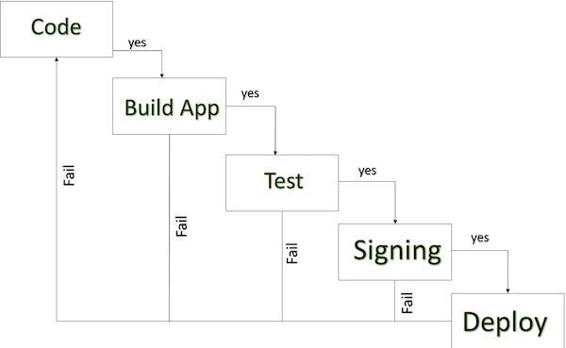
Publishing on Android Market
Source: https://www.tutorialspoint.com/android/android_publishing_application.htm

Slide 63
DAILY QUIZ 7
1. What is a digital certificate.
Keystore
Playstore
Keyapp
2. Applications signed with the debug certificate cannot be published. (T/F)
3. Which of the following method in android is used to log debug messages?
Log.r()
Log.R()
Log.d()
Log.D()

Slide 64
Publishing on Android Market
Among the information needed, the following are compulsory:
➤ The application must be in APK format
➤ You need to provide at least two screenshots. You can use the DDMS perspective in IDE to capture screenshots of your application running on the emulator or real device.
➤ You need to provide a high-resolution application icon. This size of this image must be 512 X 512 pixels.
➤ The next set of information you need to supply, includes the title of your application, its description, as well as details about recent changes (useful for application updates).
➤ You can also select the application type and the category in which it will appear in the Android Market.
➤ Finally, you indicate whether your application employs copy protection, and specify a content rating. You also supply your website URL and your contact information. When you have given your consent to the two guidelines and agreements, click Publish to publish on the Android Market.

Slide 65
Android Permissions
Topic Objective: To understand the concept of android permissions
App permissions help support user privacy by protecting access to the following:
Restricted data, such as system state and a user's contact information.
Restricted actions, such as connecting to a paired device and recording audio
Manifest.permission
public static final class Manifest.permission
extends Object
java.lang.Object
↳ android.Manifest.permission

Slide 66
Android Permissions
Workflow for using permissions
If your app offers functionality that might require access to restricted data or restricted actions, determine whether you can get the information or perform the actions without needing to declare permissions like photos, pausing media playback, and displaying relevant ads, without needing to declare any permissions.
If you decide that your app must access restricted data or perform restricted actions to fulfill a use case, declare the appropriate permissions. Some permissions, known as install-time permissions, are automatically granted when your app is installed. Other permissions, known as runtime permissions, require your app to go a step further and request the permission at runtime.
Source: https://developer.android.com/guide/topics/permissions/overview

Slide 67
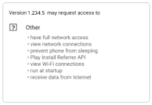
Android Permissions
Types of permissions
1. Install-time permissions
The list of an app's install-time permissions, which appears in an app store. Install-time permissions give your app limited access to restricted data, and they allow your app to perform restricted actions that minimally affect the system or other apps. When you declare install-time permissions in your app, the system automatically grants your app the permissions when the user installs your app.
Source: https://developer.android.com/guide/topics/permissions/overview

Slide 68
Android Permissions
Types of permissions
2. Normal permissions
These permissions allow access to data and actions that extend beyond your app's sandbox. However, the data and actions present very little risk to the user's privacy, and the operation of other apps.
3. Signature permissions
If the app declares a signature permission that another app has defined, and if the two apps are signed by the same certificate, then the system grants the permission to the first app at install time. Otherwise, that first app cannot be granted the permission.
Source: https://developer.android.com/guide/topics/permissions/overview

Slide 69
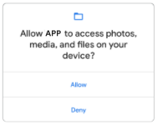
Android Permissions
Types of permissions
4. Runtime permissions
The system permission prompt that appears when your app requests a runtime permission. Runtime permissions, also known as dangerous permissions, give your app additional access to restricted data, and they allow your app to perform restricted actions that more substantially affect the system and other apps. Therefore, you need to request runtime permissions in your app before you can access the restricted data or perform restricted actions. When your app requests a runtime permission, the system presents a runtime permission prompt.
Source: https://developer.android.com/guide/topics/permissions/overview

Slide 70
Android Permissions
Types of permissions
5. Special permissions
Special permissions correspond to particular app operations. Only the platform and OEMs can define special permissions. Additionally, the platform and OEMs usually define special permissions when they want to protect access to particularly powerful actions, such as drawing over other apps.
Best practices
App permissions build upon system security features and help Android support the following goals related to user privacy:
Control: The user has control over the data that they share with apps.
Transparency: The user understands what data an app uses, and why the app accesses this data.
Data minimization: An app accesses and uses only the data that's required for a specific task or action that the user invokes.
Source: https://developer.android.com/guide/topics/permissions/overview

Slide 71
DAILY QUIZ 8
Install time permissions are granted at the time of ………
Permissions are added in which file. (android manifest file/ android xml).
An app accesses and uses only the data that's required for a specific task or action that the user invokes. (control/transparency/data minimization)

Slide 72
WEEKLY ASSIGNMENT
Explain how the persistent data storage is done in android database.
Define the various types of testing an android app.
Explain the various types of android permissions to be taken for deploying an android app.
Explain the steps involved in publishing an android app.
Comment on testing tools available for testing an android app.
Explain the best practices to be included for android application deployment.

Slide 73
TOPIC LINKS
https://developer.android.com/guide/topics/permissions/overview
https://www.tutorialspoint.com/android/android_publishing_application.htm
https://developer.android.com/studio/debug#kts
https://developer.android.com/training/testing/fundamentals
https://abhiandroid.com/database/sqlite
https://www.geeksforgeeks.org/how-to-create-and-add-data-to-sqlite-database-in-android/?ref=lbp
https://www.tutorialspoint.com/android/android_sqlite_database.htm

Slide 74
MCQ
1. The services in android can be stopped using which of the following method?
stopSelf() and stopService()
End() method
Finish() method
system.exit() method
2. What are the debugging techniques available in android?
DDMS
Breaking point
Memory profiling
None of the above.

Slide 75
MCQ
3. - How to fix crash using log cat in android?
Gmail
log cat contains the exception name along with the line number
Google search
None of the above.
4. What is log message in android?
Log message is used to debug a program.
Same as printf
Same as Toast.
None of the above.

Slide 76
MCQ
5. What is breakpoint in android?
Breaks the application
Breaks the development code
Breaks the execution
None of the above.
6. SharedPreferences stores the data in which format?
TXT
XML
DOC
None of the above.

Slide 77
MCQ
7. The first step when working with SQLite is to create a class that inherits from a helper class, what is it?
SQLiteOpenHelper class
SQLiteHelper class
SQLiteDatabaseHelper class
SQLiteDatabase class
8. How do we get access to the preference?
Via getPreference() method
Via getSharedPreference() method
Via getDefaultSharedPreference() method
All of above

Slide 78
MCQ
9. How many protection levels are available in the android permission tag?
There are no permission tags available in android
Normal, dangerous, signature, and signatureOrsystem
Normal, kernel, application
Kernel, Normal, Application
10. The android component that works like database
Services
Activities
Broadcast Receivers
Content Providers

Slide 79
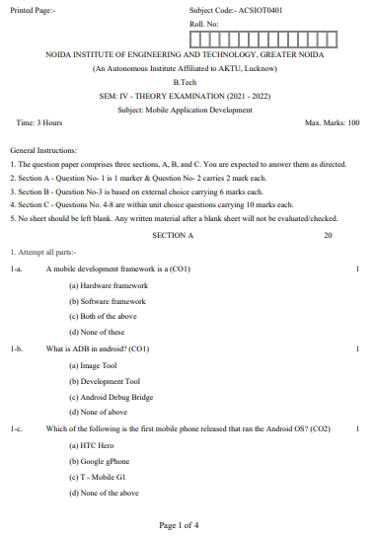
Old University Exam Question Paper

Slide 80
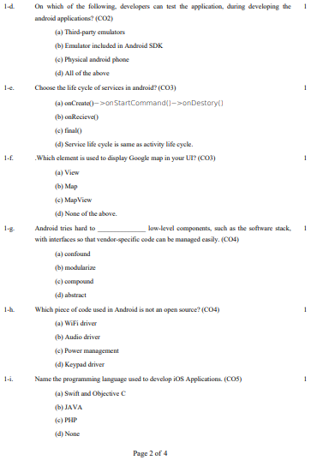
Old University Exam Question Paper

Slide 81
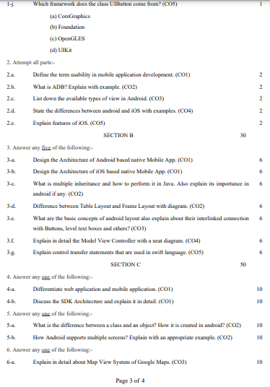
Old University Exam Question Paper

Slide 82
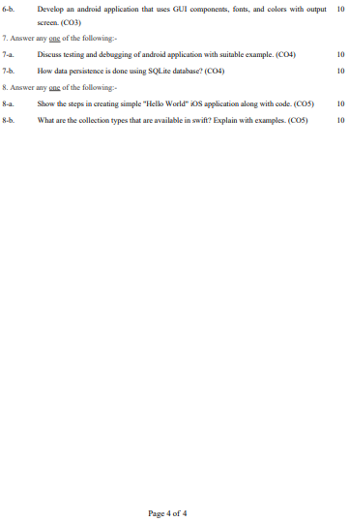
Old University Exam Question Paper

Slide 83
Expected Questions
Explain how the persistent data storage is done in android database.
Define the various types of testing an android app.
Explain the various types of android permissions to be taken for deploying an android app.
Explain the steps involved in publishing an android app.
Comment on testing tools available for testing an android app.
Explain the best practices to be included for android application deployment.
List out the standard SQLite commands?
Explain what is SQLite transactions?
What is the difference between SQL and SQLite?
Mention what are the SQLite storage classes?

Slide 84
Recap/Summary
Discussed about the persisting data using SQLite database
Testing and debugging Android Application covered.
Discussed the packaging on device with Windows
Android Application Deployment on device with Windows covered
Android Permissions discussed
Testing and publishing of Mobile Applications on different app stores discussed.

Slide 85
Noida Institute of Engineering and Technology, Greater Noida
THANK YOU !!

